Slide 1
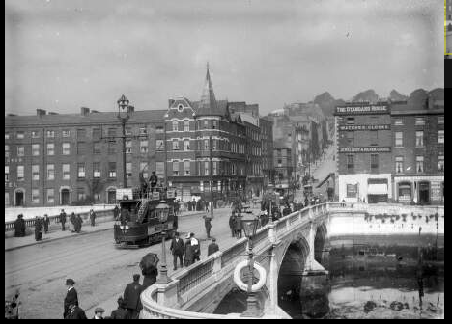
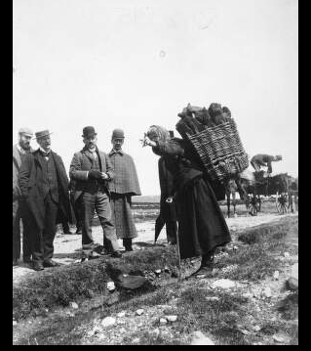
Life in 1916 Ireland: Stories from statistics

Slide 2
Life in 1916 Ireland: Stories from statistics
We searched for statistics to illustrate what life was like for people living 100 years ago
We compared to data available for today
Created an electronic publication - available on cso.ie
Contains 72 tables and Census returns for about 70 people associated with the Rising
Also created a smaller paper publication, 18 tables and Census returns for 3 men, 3 women associated with the Rising

Slide 3
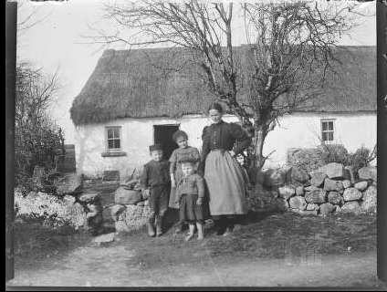
Population has increased in Ireland
3,139,688 people in 1911 - 4,588,252 by 2011
An increase of 46% or 1,448,564
Dublin County more than
quadrupled
Kildare more than tripled
Meath +183%, Wicklow +125%,
Louth +93%

Slide 4
Largest population increases in the east

Slide 5
More variety now in names for baby boys

Slide 6
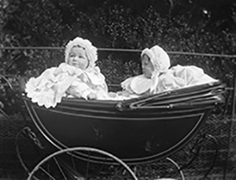
More variety now in names for baby girls also

Slide 7
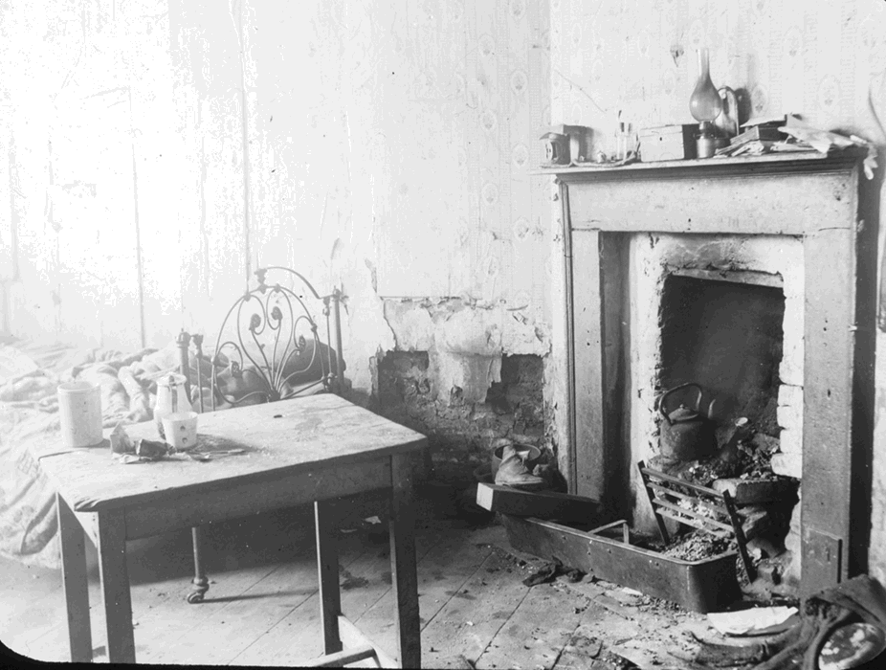
Housing in 1911
Nearly 10% of dwellings in 1911 had 10+ rooms
Compared to 2.8% in 2011
In Dublin 22% of dwellings had 10+ rooms in 1911
And 36% of Dublin dwellings
were one room tenements
Dublin was clearly place
of extremes for housing

Slide 8
People more mobile now, more inward migration

Slide 9
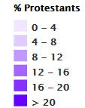
Decrease in numbers of Protestants

Slide 10
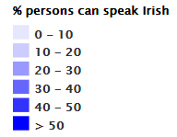
Increase in ability to speak Irish

Slide 11
Census of Population and people of the Rising
Extraordinary people doing ordinary things
Selected interesting people associated with the Rising and found their Census returns
7 signatories of the Proclamation, 9 other executed men
18 women associated with the Rising
Other men involved with the Rising
Some of the individuals involved with the British Administration
Selection of some famous people

Slide 12
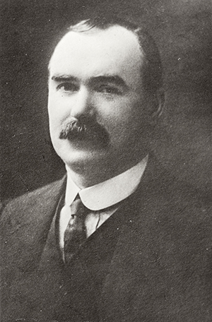
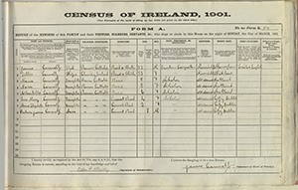
James Connolly 1868-1916
Found 1901 and 1911 Census returns for James,
wife Lillie and their children
1901 Census included daughter Mona aged 9
However Mona not included on 1911 return – she died in an accident in 1903
Occupation in 1901 - “Printer compositor”
Occupation in 1911 - “National organiser for the Socialist Party”
Executed 12 May 1916

Slide 13
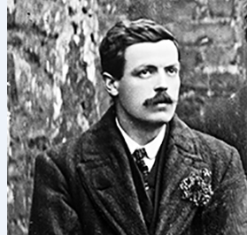
Michael O’Hanrahan 1877-1916
Found 1901 and 1911 Census returns for
Michael living with his parents and siblings
Ages of the children do not tally between the 2 Censuses
1901 filled out by Father – 1911 filled out by widowed Mother
1901- Michael aged 24, was a cork cutter
1911- Michael aged 28, was an unemployed reader for the Press

Slide 14
Francis Sheehy Skeffington 1878-1916
Found 1911 Census return for Francis, his wife Hanna and baby Owen
Francis was a well known pacifist
Arrested on Easter Tuesday
Shot dead in yard of Portobello Barracks that evening on order of Captain Bowen-Colthurst
Bowen-Colthurst found guilty but insane at court martial

Slide 15
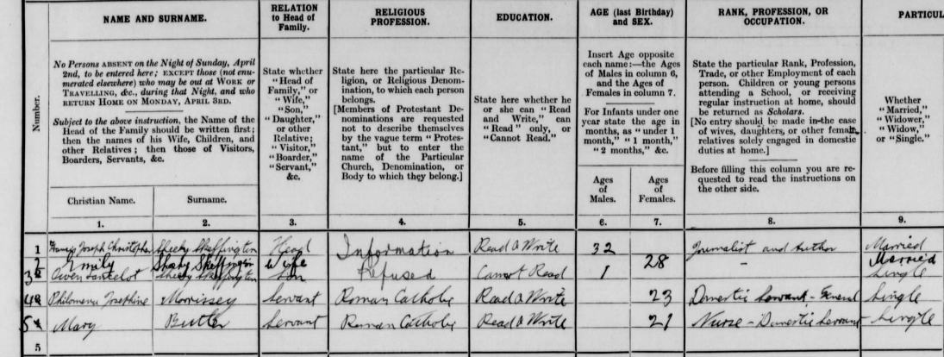
Hanna Sheehy Skeffington 1877-1946
Hanna was a suffragette
Boycotted 1911 Census
Enumerator entered her details (got name, age, length of marriage and place of birth incorrect)

Slide 16
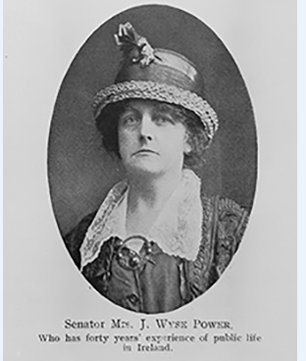
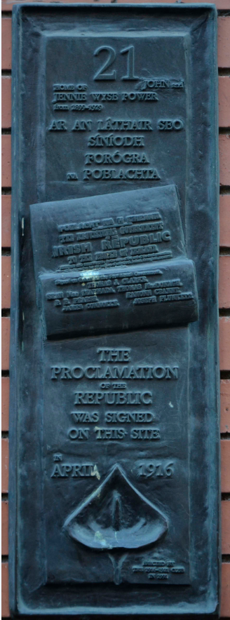
Jennie Wyse Power 1858-1941
Found the 1911 Census for
Jennie, her husband and children
Form filled out in Irish by Jennie’s husband
He got her age incorrect – entered 47 -
but she was actually 53
Signing of the Proclamation took place
at her house in Henry Street

Slide 17
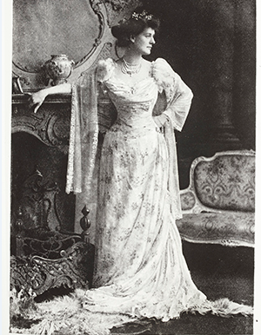
Constance Markievicz 1868-1927
No record in 1911 Census
May have been in jail
Found Census form for daughter Maeve (9)
in Sligo with Constance’s mother,
Georgina Gore Booth (67)
Five other people in the house, includes three servants
Mix of religions – Georgina and a visitor to house were Church of England
Maeve and two servants were Church of Ireland
Cook and stable boy were Catholic

Slide 18
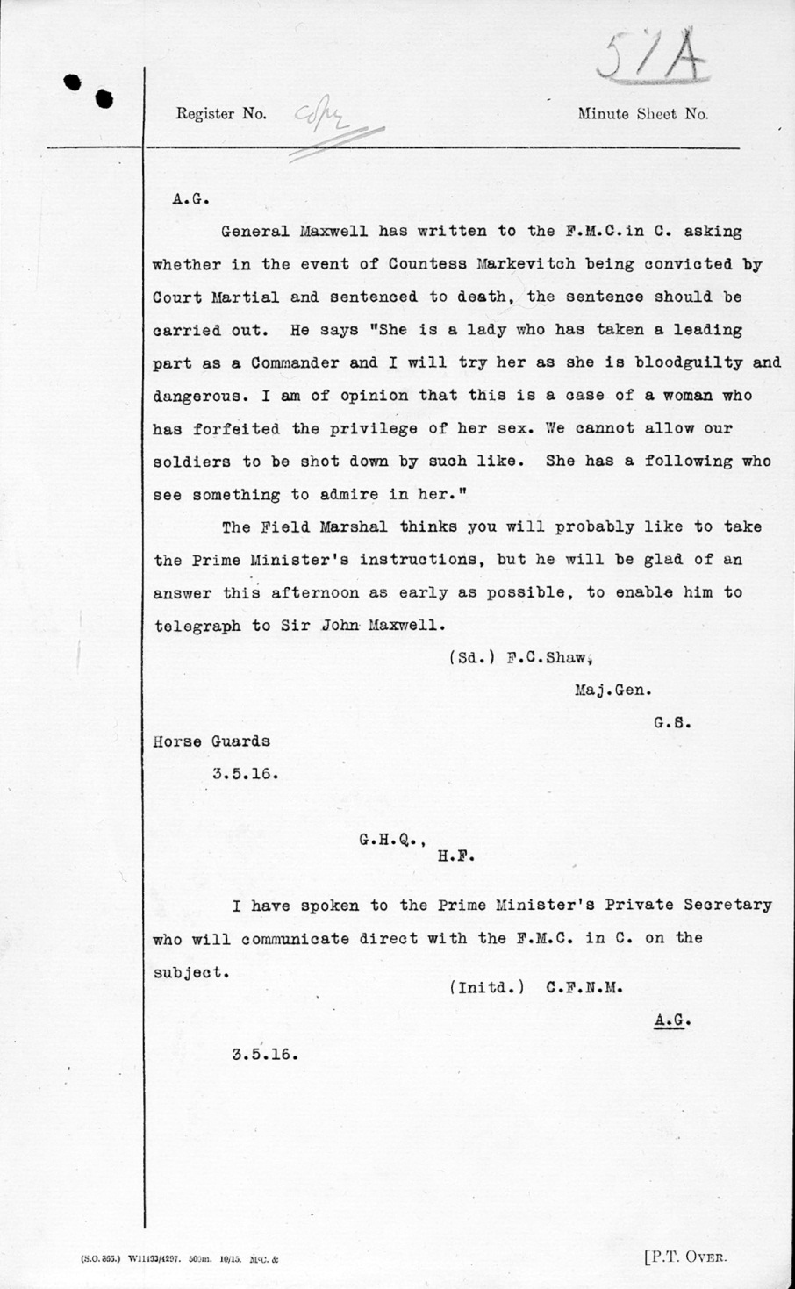

Slide 19
Persons killed and wounded during the Easter rising (Police report)

Slide 20
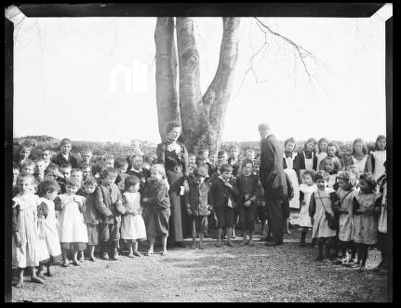
Average annual income of principals and assistant teachers, National schools, 1916
Principals Assistant Teachers
Men £115 19 shillings £83 11 shillings
& 11 pence & 4 pence
Women £92 13 shillings £70 2 shillings
& 9 pence & 3 pence

Slide 21
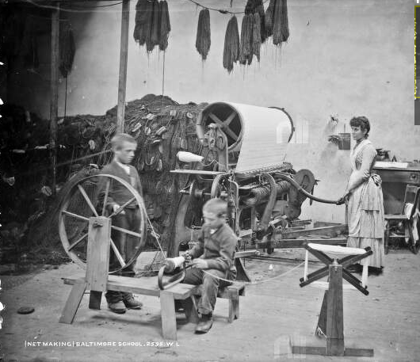
Very young children admitted to Industrial schools, 1916

Slide 22
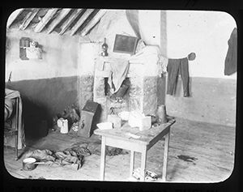
Infant mortality very high in Dublin city in 1916

Slide 23
Rise in births outside marriage

Slide 24
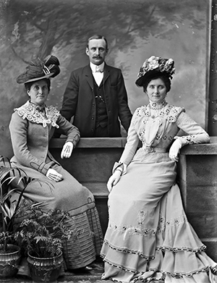
Rise in Civil and Other marriage ceremonies

Slide 25
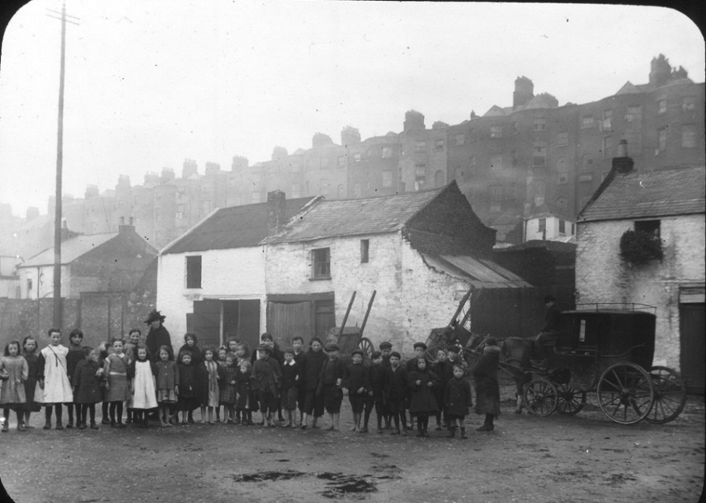
Bronchitis, pneumonia, TB were main causes of the 50,627 deaths in Ireland in in 1916

Slide 26
Deaths spread over all age groups in 1916

Slide 27
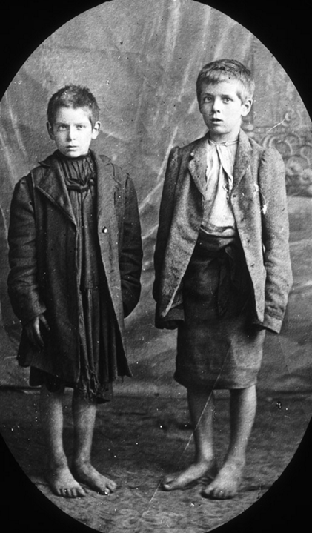
Life expectancy increased, especially for younger ages

Slide 28
Government revenue soared during war

Slide 29
Food dominated 1922 CPI weights

Slide 30
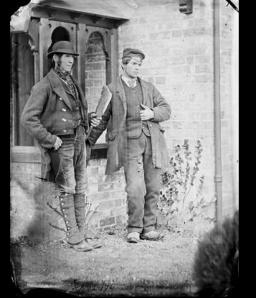
Number of farms has dropped

Slide 31
East had highest number of rented farms in 1916

Slide 32
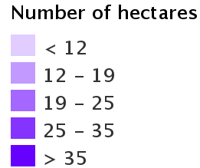
Average farm size has increased

Slide 33
There were cars in each county in 1915

Slide 34
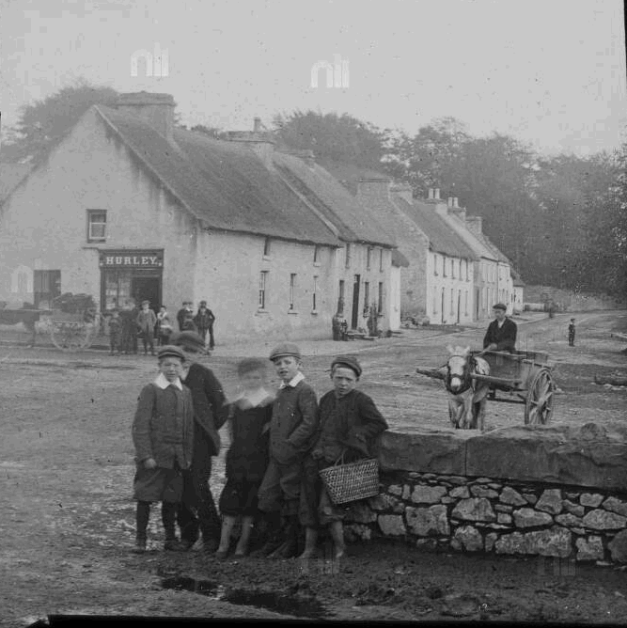
Thank you!

