Slide 1
Analysis of GHG Emissions in air transport by Gregg Patrick

Slide 2
Overview
Timeline to project
Work done to date
Some methodological issues
Preliminary results for GHG emissions, 2005-2010
Further developments

Slide 3
Timeline
  Sep 2009 Project initiation (phase 1)
  Nov 2009 Presentation of method at Business
  Statistics Seminar, Dublin
  Nov 2010 Joint discussion with Eurostat
  Feb 2011 Project restarted (phase 2)
  May 2011 Preliminary results available

Slide 4
Work Done (Phase 1)
Aircraft Fuel Burn Source: EMEP
/EEA
Aircraft Type
Fuel burn /Distance GHG emissions
Country of Residence Source: CSO
Origin
Passengers
Country of Residence
Aviation Transport A1 Dataset Source: CSO
Origin
Flights
Aircraft Type
Great Circle Distance Source: GCM
Irish Airport (Lat/Long)
Foreign Airport (Lat/Long)
Great Circle Distance
Passengers
Destination
Destination

Slide 5
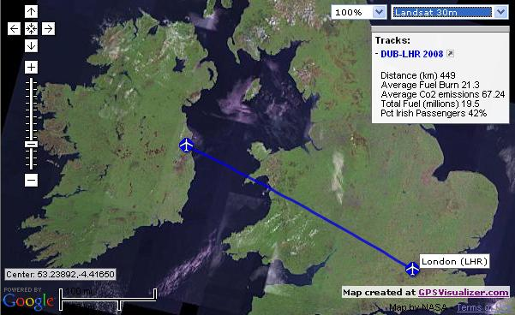
Work Done (Phase 1)

Slide 6
Work Done (Phase 2)
Aviation Transport A1 Dataset Source: CSO
Aircraft Fuel Burn Source: EMEP/EEA
Eurocontrol Dataset
Year
Month
Day
Origin
Departure
Mean Distance
Year
Month
Origin
Departure
Aircraft Type
Flights
Passengers
Freight & Mail
Seats
Aircraft Type
Fuel Burn/Distance GHG emissions

Slide 7
Key problems with EMEP/EAA data
Only 19 jet aircraft types represented
  Many modern jet types missing (e.g. Boeing 737-800)
  No small executive jets (e.g. Learjet)
Only 25 turboprop aircraft types represent
  Only one small turboprop (Cessna 208 Caravan)

Slide 8
Ad hoc solution - Concordance

Slide 9
Preliminary Results
2005-2010

Slide 18
Conclusions from experience to date:
Wealth of information to be attained
  (Aircraft kms, passenger kms, tonne-kms, CO₂, NO_{x}, HC, CO, CO₂ per passenger, CO₂ per tonne of freight, by airport, route, aircraft type, etc.)
Process relatively straightforward
Use of Eurocontrol data adds refinement
Only significant problem is the limitation of the EMEP/EEA datasets

Slide 19
Further developments
Jul 2011 Investigation of Eurocontrol ‘Small Emitters Tool’
Aug 2011 Presentation of paper at ITRN conference
Dec 2012(?) Dissemination of results on CSO StatBank
service

