Slide 1
CSO Environment Statistics and Accounts
A Broad View of Environment Statistics
6th Administrative Data Centre Seminar, Dublin
Gerry Brady, Environment Statistics and Accounts, CSO
October 24th, 2017

Slide 2
Presentation Structure
Eurostat environmental economic accounts
Eurostat environmental statistics
Administrative microdata
Surveys and dissemination
Planned and potential new releases
Statistical collaboration

Slide 3
Eurostat Environmental Economic Accounts
Regulation (EU) No 691/2011 contained three modules (1st wave):
1 Air Emission Accounts (first delivery by September 2013)
2 Environmental Taxes (first delivery by September 2013)
3 Material Flow Accounts (first delivery by December 2013)
Regulation (EU) No 538/2014 added three more modules (2nd wave):
4 Environmental Protection Expenditure Accounts (first delivery by Dec. 2017)
5 Environmental Goods and Services (first delivery by December 2017)
6 Physical Energy Flow Accounts (first delivery by September 2017)

Slide 4
Eurostat Environmental Economic Accounts
Some questionnaires are completed on a voluntary basis so compliance rates are lower:
- Forest Accounts
- Water Accounts
- Environmental Subsidies
- Resource Management Expenditure Accounts

Slide 5
Eurostat Methodological Approach
Harmonised statistics achieved through:
United Nations reference methodology (SEEA)
Working Groups
Task Forces
Manuals
Questionnaires

Slide 6
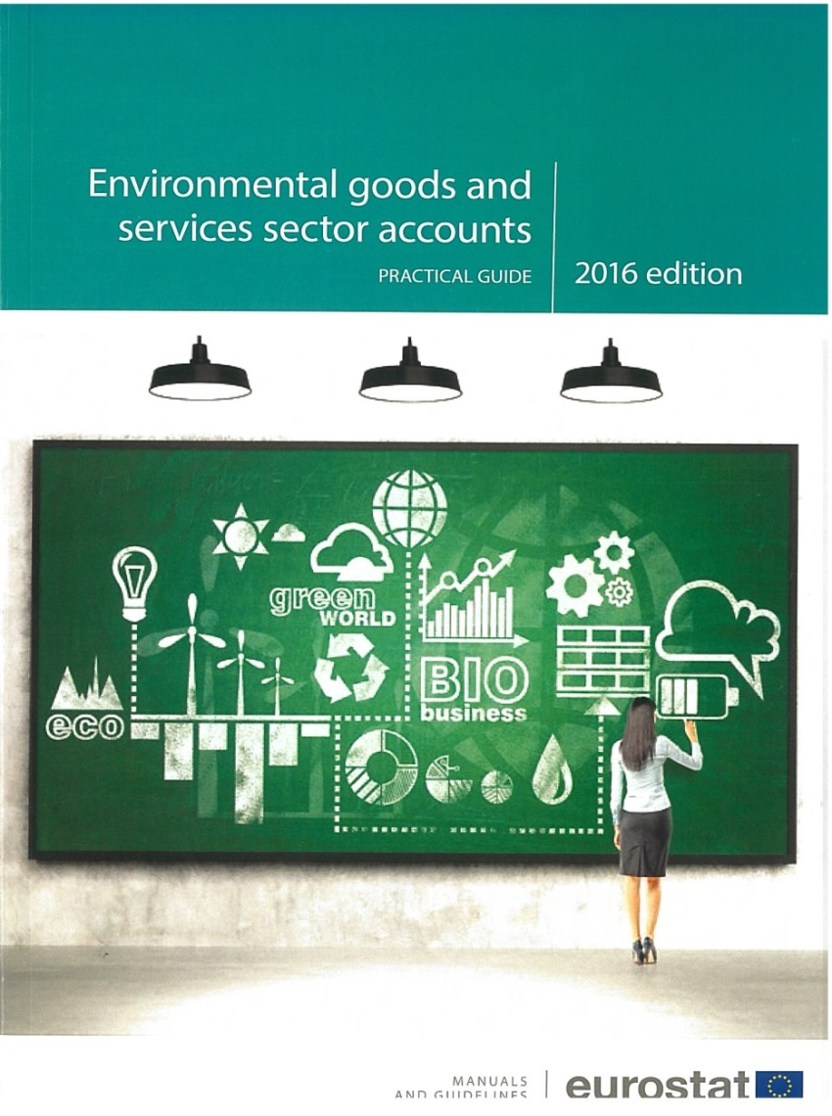
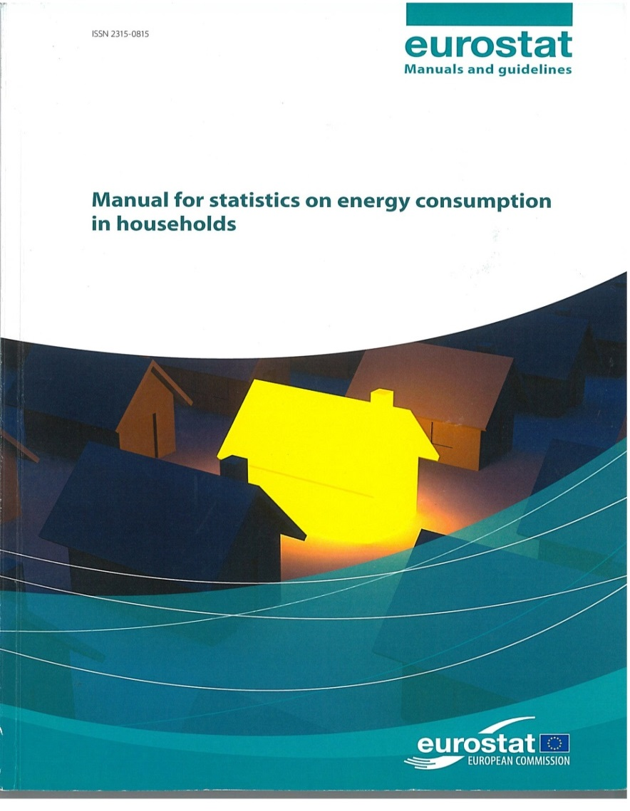

Slide 7
SEEA
System of Environmental Economic Accounts
Consistent with National Accounts
Residence not territorial principle

Slide 8
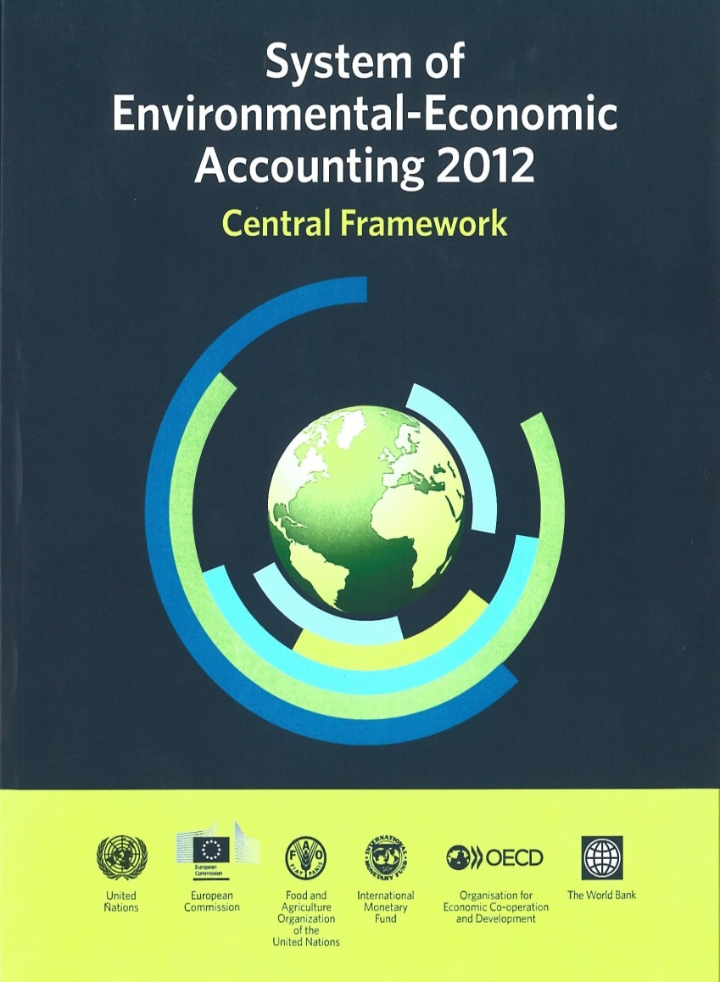

Slide 9
Eurostat Environmental Statistics
Waste Statistics Regulation (EPA and NWCPO)
Energy Statistics Regulation (SEAI)
Forestry Statistics (D/Agriculture)
Land Cover and Land Use (EPA, Forest Service, Ordnance Survey, …)
Fishery Statistics (SFPA)
Aquaculture Statistics (Marine Institute)
Monthly Oil and Gas Statistics (D/CCAE)

Slide 10
Dissemination
http://www.cso.ie/en/statistics/environment/
- 4 releases from environmental accounts
- 5 releases based on administrative data
- 1 household environment module release
- Environment indicators report
- Sustainable Development indicators report

Slide 11
Location of Residential Gas Meters

Slide 12
Planned New Releases
Business energy use survey
Fishery statistics
Fuel sales (e.g. filling stations)
Waste statistics
2nd wave environmental accounts modules

Slide 13
Potential Releases
Non-domestic water meters
Electricity meters
Forestry statistics
Agri-environment indicators
Climate change indicators (UNECE)
Green procurement

Slide 14
Administrative Microdata
Environment-related administrative data (examples)
Domestic water meter data (Irish Water)
Gas meter data (Gas Networks Ireland)
Building Energy Ratings (SEAI)
Fuel distribution movements (Revenue)
National Forest Inventory (Forest Service)
Land Parcel Information System (D/Agriculture)
Odometer readings (Road Safety Authority + D/Transport)
Septic tank register (LGMA)

Slide 15
Integrating Microdata
Linking microdata files to add value e.g. linking odometer readings with vehicle characteristics with NACE sector of vehicle owners:
Eircodes
Geodirectory X/Y and Building ID
Enterprise numbers (VAT and CRO numbers )
Spatially e.g. data at county level
Thematic (NACE, CEPA/CReMA, Household)

Slide 16
Aichi Biodiversity target 2
By 2020, at the latest, biodiversity values … are being incorporated into national accounting
Environment statistics are very broad ranging
Need to understand trends in an integrated way
Current and future impacts on terrestrial and marine ecosystems, human health, fuel poverty, air and water quality, social life and living conditions

Slide 17
Statistical Collaboration
Memoranda of Understanding
http://www.cso.ie/en/aboutus/descriptionsandfunctions/memorandumsofunderstanding/
Liaison groups
Environmental Protection Authority
Sustainable Energy Authority of Ireland
Department of Agriculture (Forest Statistics)
Department of Housing (Water Statistics)

Slide 18
Statistical Collaboration
Data collection needs to be informed by input from policy bodies such as: Department of Communications, Climate Change and the Environment; EPA; SEAI; Marine Institute; NPWS; and NESC
Is there a need for an overall high-level environment statistics liaison group comprising the main data owners to ensure efficiency in data collection through more formal coordination

Slide 19
Thank You

